Slide 1
Business Analyst Internship Assignment - Nebula9.ai
AI-Driven Financial Risk Management
Prepared by: Parinita Singh

Slide 2

Overview
Implement an AI-powered system to enhance financial risk management, focusing on identifying high-risk clients, predicting market volatility, and mitigating financial risks.
Key Takeaway
The AI system will automate risk detection, improve accuracy, reduce costs, and enhance decision-making efficiency.

Slide 3

Problem Statement
1
Challenges
Manual Processes: Risk assessments are time-consuming and prone to errors.
Prediction Gaps: Existing methods lack real-time updates, causing delays in responding to market changes.
Missed Early Warnings: Results in financial losses and increased regulatory pressure.
2
Impact
Increased financial losses and exposure
Regulatory fines and compliance issues
Damage to reputation and customer trust

Slide 4
Proposed AI Solution
Solution Overview
Deploy an AI-driven system that uses machine learning for real-time risk assessment and market volatility prediction.
How It Works!??
Data Collection: Aggregate and analyze transaction and market data.
Risk Detection: Identify patterns and threats using AI algorithms.
Real-Time Insights: Generate alerts and recommendations for risk mitigation.

Slide 5

AI System Overview
Key Features
Data Integration: Combines internal and external data for a comprehensive view.
AI Models: Utilizes advanced algorithms for risk prediction and anomaly detection.
Dashboard: Provides an intuitive interface for monitoring risks.
Alerts: Issues real-time notifications for high-risk scenarios.
Technical Details
Models: Machine learning for classification and anomaly detection.
Data Sources: Transactional data, market indicators, and risk factors.

Slide 6
Expected Benefits
Enhanced Accuracy
Achieves 95% accuracy in identifying high-risk clients and transactions.
Real-Time Predictions
Proactively manages market volatility to prevent potential losses.
Operational Efficiency
Reduces manual risk assessment efforts by 40%, reallocating resources effectively.
Cost Reduction
Expected to cut financial losses by 20% through early detection.
Compliance Improvement
Ensures adherence to regulatory requirements with built-in auditing features.

Slide 7
Current Annual Cost (without AI System)
Cost Category | Amount
Manual Labor for Risk Analysis (e.g., additional analysts to manually assess risk) | $60,000
Data Processing and Reporting (manual data collection and analysis) | $30,000
Staff Training (for manual processes and systems) | $15,000
Maintenance and Support (manual processes require constant oversight and adjustments) | $25,000
Total Recurring Costs | $130,000

Slide 8
Cost Estimates & ROI Projections
Cost Category | Amount
Implementation Costs
AI Model Development | $100,000
Data Infrastructure | $50,000
System Integration | $30,000
Total Implementation Costs | $180,000
Recurring Costs (Annually)
Maintenance and Support | $20,000
Data Refresh and Model Retraining | $15,000
Staff Training | $10,000
Total Annual Costs | $45,000
Revenue Impact
Improved investment decisions and reduction in manual interventions will result in annual saving of $85,000.

Slide 9

Risk Mitigation Insights
Potential Risks | Mitigation Strategies
Data Privacy: Risk of exposing sensitive information | Data Privacy: Implement strong encryption and privacy controls.
Model Accuracy: Potential for inaccuracies in predictions. | Model Accuracy: Regularly retrain models and perform bias checks.
System Integration: Challenges integrating with existing systems. | System Integration: Use phased integration with comprehensive testing.
Regulatory Compliance: Ensuring adherence to legal standards. | Regulatory Compliance: Conduct regular audits and consult with compliance experts.

Slide 10
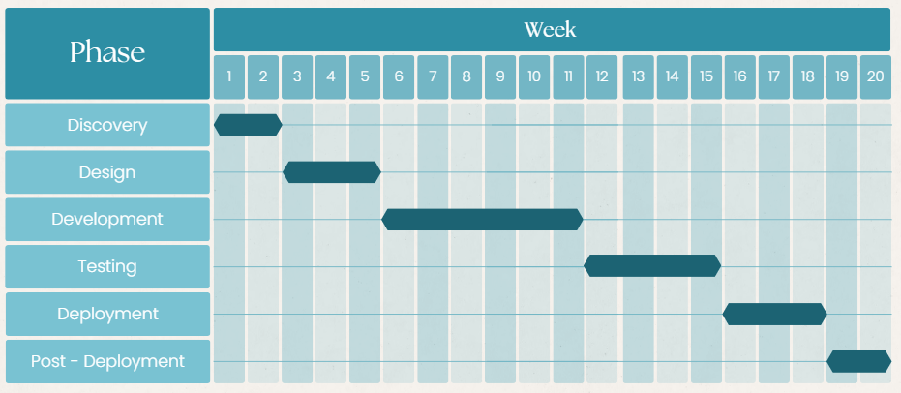
Implementation Plan
Phases to deploy AI for risk management
Discovery Phase: Requirements gathering and stakeholder meetings.
Design Phase: System architecture development and data strategy formulation.
Development Phase: AI model training and system integration.
Testing Phase: Model validation and performance testing.
Deployment Phase: System rollout and user training.
Post-Deployment Phase: Monitoring and support.

Slide 11
Summary and Call to Action
The AI-driven financial risk management system offers significant improvements in risk detection, operational efficiency, and cost reduction. The investment is justified by the substantial expected ROI and long-term benefits.
Next Steps
Approval: Seek leadership endorsement to proceed.
Resource Allocation: Finalize resources and project timeline.
Kickoff: Initiate the discovery phase within one month.
Call to Action
Let’s advance our financial risk management capabilities with AI!

